Slide 1




Employee Management System (EMS)
Built using React, Vite, Tailwind CSS, React Router, Context API, Custom Hooks, and Reusable Components

Slide 2
Project Overview
Challenges
Managing employee information manually is time-consuming.
Difficulty tracking attendance and payroll data.
Lack of centralized employee records.
Limited visibility into department-wise employee statistics.
Solution
Centralized employee management platform
Department wise employee tracking
Attendance monitoring and reporting
Payroll management dashboard
Secure access using simulated authentication and protected route
Notes:
Slide 2: Project Overview
Title
Project Overview
Layout
Use a 2-column layout.
Left Side: Problem Statement
Challenges
Managing employee information manually is time-consuming.
Difficulty tracking attendance and payroll data.
Lack of centralized employee records.
Limited visibility into department-wise employee statistics.
Right Side: Solution
Employee Management System (EMS)
Centralized employee management platform.
Department-wise employee tracking.
Attendance monitoring and reporting.
Payroll management dashboard.
Secure access using authentication and protected routes.
Bottom Section
Key Modules
ModulePurposeDashboardSummary & analyticsEmployeesEmployee managementDepartmentsDepartment managementAttendanceAttendance trackingPayrollPayroll information
Speaker Notes
The Employee Management System was developed to provide a centralized platform for managing employee-related information. The application allows users to view employees, departments, attendance records, and payroll details through a responsive and secure interface.
Visual Suggestion
On the right side add a simple flow diagram:
Login
↓
Dashboard
↓
┌─────────────┬─────────────┬─────────────┐
Employees Departments Attendance
↓
Payroll
This slide tells reviewers what the application does before discussing technology.
Once Slide 2 is ready, we'll create Slide 3: Business Requirements & SMART Objective Mapping, which directly aligns your project work with the SMART objective shown in your screenshot.

Slide 3
Objective achievement
Reusable components
Header
DataTable
Sidebar
Breadcrumb
Filters
React best practices
Functional Component
React hooks
Custom hooks
Context API for authentication
Proptype validation
ESLint & Clean code
Shared table component
Shared card component
Shared filtering logic with custom hooks
Code quality
Feature-based folder structure
Utility functions separated by /utils
API layer separated into /api
Centralized constants
Layout component for shared page structure
Notes:
Slide 3: SMART Objective Achievement
Title
SMART Objective Alignment
Objective
Improve the quality and maintainability of the React application by developing reusable components and following coding standards.
What Was Implemented
Reusable Components
✅ Developed reusable UI components in components/common
DataTable
Header
Sidebar
Breadcrumb
Filters
InfoCard
EmptyState
PageLoader
React Best Practices
✅ Followed modern React development standards
Functional Components
React Hooks
Custom Hooks
Context API
PropTypes Validation
Separation of Concerns
Code Quality Improvements
✅ Improved maintainability and scalability
Feature-based folder structure
Utility functions separated into /utils
API layer separated into /api
Constants centralized
Layout components for shared page structure
ESLint & Clean Code
✅ Reduced code duplication
Shared table components
Shared card components
Shared filtering logic through custom hooks
Success Measures Achieved
RequirementStatusProtected Routing✅ CompletedReusable Components✅ 6+ ComponentsAPI Integration✅ CompletedLoading/Error Handling✅ ImplementedCode Reusability✅ Achieved
Visual (Recommended)
Create a simple achievement diagram:
SMART Objective
│
▼
Reusable Components
│
▼
Custom Hooks
│
▼
Protected Routes
│
▼
Clean Architecture
│
▼
Maintainable Application
Speaker Notes
This project was developed with a strong focus on maintainability and code quality. Reusable components were created to eliminate duplication, custom hooks were used for business logic reuse, and React best practices such as Context API, PropTypes, and protected routing were implemented to ensure scalability and clean architecture.
Why this slide matters
Reviewers usually ask:
"How does your implementation satisfy the objective?"
This slide answers that question before they even ask.
Next Slide (Slide 4)
Technology Stack & Why Each Technology Was Chosen
This is where you'll explain:
Why Vite instead of CRA
Why React Router
Why Tailwind CSS
Why Context API
Why PropTypes
Why Custom Hooks
That slide is usually one of the strongest technical discussion points during a walkthrough.

Slide 4
Technology Stack
React
Component based architecture
Reusable UI development
Large ecosystem and community support
React-router
Client-side navigation
Nested routes
Protected route implementation
Vite
Faster startup time
Instant hot module replacement
PropTypes
Run time prop validation
Easier debugging
Improved maintainability
Tailwind CSS
Utility first CSS framework
Consistent design system
Reduced custom CSS maintenance
Notes:
Slide 4: Technology Stack
Title
Technology Stack & Architecture Choices
Frontend Framework
React
Why React?
Component-based architecture
Reusable UI development
Efficient rendering with Virtual DOM
Large ecosystem and community support
Build Tool
Vite
Why Vite?
Faster startup time
Instant Hot Module Replacement (HMR)
Optimized production builds
Better developer experience than Create React App
Styling
Tailwind CSS
Why Tailwind CSS?
Utility-first CSS framework
Rapid UI development
Consistent design system
Reduced custom CSS maintenance
Routing
React Router
Purpose
Client-side navigation
Route management
Nested routes
Protected routes implementation
State Management
Context API
Purpose
Authentication management
Global state sharing
Avoid prop drilling
Lightweight alternative to Redux for this project
Type Validation
PropTypes
Purpose
Runtime prop validation
Better component reliability
Easier debugging
Improved maintainability
Custom Hooks
Why Custom Hooks?
Used to:
Reuse business logic
Keep components clean
Separate UI from logic
Examples from project:
useDashboardSummary()
useEmployeeFilters()
useAttendanceFilter()
useDepartmentSummary()
usePayRollFilters()
Suggested Visual Layout
Create a stack diagram:
┌──────────────────────────┐
│ React + Vite │
├──────────────────────────┤
│ React Router │
├──────────────────────────┤
│ Context API │
├──────────────────────────┤
│ Custom Hooks │
├──────────────────────────┤
│ Tailwind CSS │
├──────────────────────────┤
│ APIs Layer │
└──────────────────────────┘
Speaker Notes
The application is built using a modern React stack. Vite provides fast development and optimized builds, React Router manages navigation, Context API handles authentication state, Tailwind CSS enables rapid styling, and custom hooks improve code reuse and maintainability.
Slide 5 (Very Important)
Application Architecture
This is where we'll use your actual folder structure and show reviewers that the project follows a clean, scalable architecture. Since you already shared the complete project structure, Slide 5 can be tailored specifically to your project rather than being generic.

Slide 5
Application Architecture
Project Structure
src
|
|── pages
|── components
| └── common
|── hooks
|── api
|── context
|── layout
|── utils
|── constants
|── assets
|── router.js
|── App.jsx
└── main.jsx
Architecture flow
Pages
Component
Hooks
Reusable component
Utility
API
Data Source
Notes:
Slide 5: Application Architecture
Title
Project Architecture & Folder Structure
Architecture Overview
The application follows a modular and scalable architecture, where responsibilities are separated into dedicated layers.
Architecture Flow
User Interface (Pages)
│
▼
Reusable Components
│
▼
Custom Hooks
│
▼
API Layer
│
▼
Data Source
Project Structure
Use a simplified version of your actual folder structure:
src
│
├── pages
├── components
│ └── common
├── hooks
├── api
├── context
├── layout
├── utils
├── constants
├── assets
│
├── router.js
├── App.jsx
└── main.jsx
Folder Responsibilities
FolderResponsibilitypagesApplication screenscomponentsReusable UI componentscommonShared generic componentshooksReusable business logicapiAPI communication layercontextGlobal authentication statelayoutShared page layoutsutilsData transformation logicconstantsApplication constants
Example Flow
Show one real example from your project:
Employees Page
│
▼
EmployeeTable Component
│
▼
useEmployeeFilters Hook
│
▼
employeeApi.js
│
▼
API Response
This demonstrates separation of concerns.
Key Design Principles Followed
Separation of Concerns
UI in Components
Business Logic in Hooks
Data Access in API Layer
Reusability
Shared tables
Shared cards
Shared layouts
Scalability
Easy to add new modules
Minimal impact on existing code
Speaker Notes
The application is organized using a layered architecture. Pages focus on user interactions, components handle UI rendering, hooks contain reusable business logic, APIs manage data access, and utility files handle transformations. This structure improves maintainability and supports future scalability.
Visual Tip
Instead of showing the entire folder tree, use colored boxes:
Pages
↓
Components
↓
Hooks
↓
API Layer
↓
Data
It looks much cleaner in PowerPoint than a huge folder structure.
Slide 6 (One of the strongest slides)
Routing & Navigation Architecture
Using your:
router.js
ProtectedRoute.jsx
Login.jsx
5 main pages
We'll create a route flow diagram that directly satisfies the SMART objective requirement of "Application successfully demonstrates routing with all 5 pages and protected navigation."

Slide 6
Routing & Navigation Architecture
Login
Authentication
Valid
Invalid
Dashboard
Employees
Departments
Attendance
Payroll
Notes:
Slide 6: Routing & Navigation Architecture
Title
Routing & Protected Navigation
Routing Strategy
The application uses React Router to manage navigation between pages while ensuring secure access through protected routes.
Main Routes
RoutePage/loginLogin/dashboardDashboard/employeesEmployees/departmentsDepartments/attendanceAttendance/payrollPayroll
Route Flow Diagram
Login
│
Authentication
│
┌─────────┴─────────┐
│ │
Invalid Valid
│ │
▼ ▼
Login Page Dashboard
│
┌──────────────┬──────────────┬──────────────┐
▼ ▼ ▼ ▼
Employees Departments Attendance Payroll
Protected Route Implementation
Purpose
Restrict access to authorized users
Prevent direct URL access without login
Redirect unauthenticated users to Login page
Component Used
ProtectedRoute.jsx
Workflow
User Requests Route
│
▼
ProtectedRoute
│
▼
Is User Authenticated?
│
┌────┴────┐
│ │
Yes No
│ │
▼ ▼
Render Redirect
Page to Login
Authentication Management
Context API
Files Used:
context/
├── AuthContext.js
└── AuthProvider.jsx
Responsibilities:
Store authentication state
Share user session globally
Handle login/logout functionality
Support protected navigation
Benefits Achieved
✅ Secure Route Access
✅ Better User Experience
✅ Centralized Authentication Logic
✅ Scalable Navigation Structure
Speaker Notes
React Router is used to manage navigation across the application. A ProtectedRoute component ensures that only authenticated users can access the Dashboard, Employees, Departments, Attendance, and Payroll pages. Authentication state is maintained globally using Context API, providing a secure and scalable routing solution.
Visual Enhancement
If possible, insert a screenshot of:
Login page
Sidebar navigation
Dashboard after login
Then place arrows showing the navigation flow. Reviewers usually appreciate seeing the actual application rather than only diagrams.
Slide 7 (Highly Important)
Reusable Components Strategy
This slide is where you prove you met the objective:
"Develop at least 3 existing components into reusable React components."
Your project actually has 8+ reusable components, so this will be one of your strongest slides. We'll use your actual components/common folder and show before/after reusability.

Slide 7
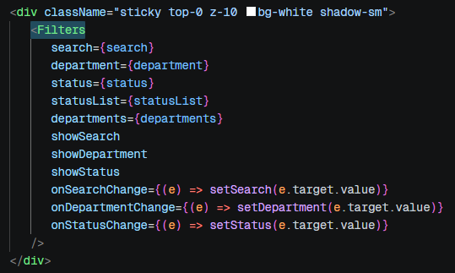
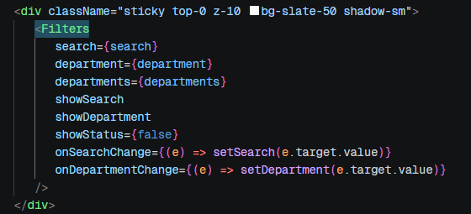
Reusable Components
Employee.jsx
Attendance.jsx
InfoCard.jsx, DataTable.jsx, StatCard.jsx, NotFound.jsx, EmptyState.jsx, PageLoader.jsx
Notes:
Slide 7: Reusable Components Strategy
Title
Reusable Components Implementation
Objective
Develop reusable React components to improve maintainability, reduce duplication, and ensure consistency across the application.
Reusable Components Created
Common Components
Located in:
components/common/
ComponentPurposeHeaderCommon page headerSidebarNavigation menuBreadcrumbNavigation pathDataTableReusable table displayFiltersGeneric filtering UIInfoCardSummary information displayEmptyStateNo data statePageLoaderLoading indicator
Feature Reusable Components
ComponentReused InEmployeeCardEmployee ModuleDepartmentCardDepartment ModuleAttendanceCardAttendance ModulePayrollCardPayroll ModuleStatCardDashboardPayrollStatCardPayroll Summary
Reusability Example
Without Reusable Components
Employee Page
└─ Custom Table
Department Page
└─ Custom Table
Attendance Page
└─ Custom Table
Problems:
Duplicate code
Difficult maintenance
Inconsistent UI
With Reusable Components
Employee Page
│
Department Page
│
Attendance Page
│
Payroll Page
│
▼
DataTable
Benefits:
Single source of truth
Easier maintenance
Consistent UI experience
Example: DataTable Component
One generic table component can display:
✅ Employees
✅ Departments
✅ Attendance Records
✅ Payroll Records
by passing different props.
Component Hierarchy
MainLayout
│
├── Header
├── Sidebar
│
└── Pages
│
├── Dashboard
│ └── StatCard
│
├── Employees
│ └── DataTable
│
├── Departments
│ └── DataTable
│
├── Attendance
│ └── DataTable
│
└── Payroll
└── DataTable
Benefits Achieved
Code Reusability
Reduced duplication
Consistency
Uniform design across modules
Maintainability
Changes made in one component reflect everywhere
Scalability
New modules can reuse existing components
Speaker Notes
To satisfy the SMART objective, reusable components were developed and organized into a dedicated common components folder. Components such as DataTable, Header, Sidebar, Filters, and InfoCard are shared across multiple modules, reducing code duplication and improving maintainability. This approach ensures a consistent user interface throughout the application.
Presentation Tip
For maximum impact, add a screenshot showing:
Employee Table
Department Table
Attendance Table
Then add a note:
"All tables are rendered using the same reusable DataTable component."
That visually proves reusability.
Slide 8
Custom Hooks & Business Logic Reusability
This is another strong technical slide because your project contains:
useAttendanceFilter
useAttendanceDetailsFilter
useAttendanceSummary
useDashboardSummary
useDepartmentSummary
useEmployeeFilters
usePayRollFilters
and demonstrates advanced React practices beyond basic component development.

Slide 8
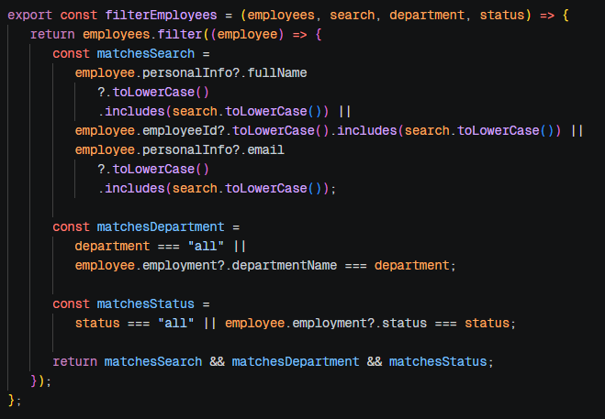
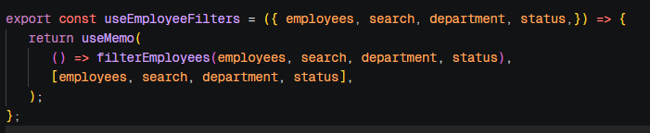
Custom Hooks
employee.util.js
useEmployeeFilters.js
useAttendanceFilter.js, useAttendanceDetailsFilters.js, useAttendanceSummary.js, useDashboardSummary.js
Notes:
Slide 8: Custom Hooks & Business Logic Reusability
Title
Custom Hooks for Reusable Business Logic
Why Custom Hooks?
Custom hooks were created to:
Reuse business logic across components
Keep UI components clean and focused
Improve code readability
Reduce code duplication
Follow React best practices
Custom Hooks Implemented
Located in:
hooks/
HookResponsibilityuseDashboardSummaryDashboard statisticsuseEmployeeFiltersEmployee filteringuseDepartmentSummaryDepartment analyticsuseAttendanceFilterAttendance filteringuseAttendanceDetailsFilterAttendance details filteringuseAttendanceSummaryAttendance statisticsusePayRollFiltersPayroll filtering
Architecture Flow
UI Component
│
▼
Custom Hook
│
▼
Business Logic
│
▼
Processed Data
│
▼
Rendered UI
Example: Employee Filtering
Before
Employees Component
├─ UI Logic
├─ Filter Logic
├─ Search Logic
├─ Sorting Logic
└─ Rendering Logic
Result:
Large component
Hard to maintain
After
Employees Component
│
▼
useEmployeeFilters()
│
▼
Filtered Employees
Result:
Cleaner component
Better separation of concerns
Reusable filtering logic
Real Project Example
Employees.jsx
│
▼
useEmployeeFilters()
│
▼
Filtered Employee Data
│
▼
EmployeeTable.jsx
Benefits Achieved
Reusability
Logic can be shared across components
Maintainability
Easier debugging and updates
Clean Components
UI code remains focused on presentation
Scalability
New filters can be added without modifying UI components
Key React Principle Followed
Separation of Concerns
LayerResponsibilityComponentsUI RenderingHooksBusiness LogicAPI LayerData RetrievalUtilsData Processing
Speaker Notes
To improve maintainability and code reuse, business logic was extracted into custom hooks. Instead of embedding filtering and summary calculations directly inside components, hooks such as useEmployeeFilters and useDashboardSummary encapsulate the logic, making components simpler and easier to manage.
Visual Enhancement
You can include a screenshot of:
Employees page with filters
Attendance page with filters
Then add a caption:
"Filtering functionality is powered by reusable custom hooks rather than component-level logic."
This demonstrates a professional React architecture.

Slide 9
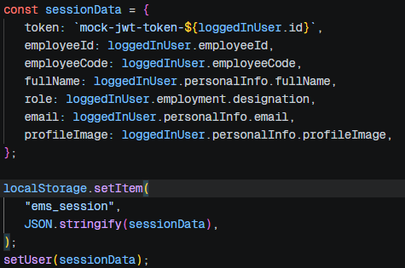

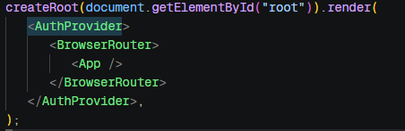
Authentication
Creating session data and store it in local storage
Creating context for sessionData along with login & logout functionality
Providing context to main application
Notes:
Slide 9: State Management & Authentication
Title
State Management & Authentication Flow
Why Context API?
The application uses React Context API to manage authentication state globally.
Benefits
Avoids prop drilling
Centralized authentication management
Easy access across components
Lightweight solution for project requirements
Authentication Files
Located in:
context/
├── AuthContext.js
└── AuthProvider.jsx
Authentication Architecture
AuthProvider
│
▼
AuthContext
│
▼
Application Components
│
▼
Protected Routes
Login Flow
User Login
│
▼
Validate Credentials
│
▼
Update AuthContext
│
▼
Authentication State = True
│
▼
Navigate to Dashboard
Route Protection Flow
User Accesses Route
│
▼
ProtectedRoute
│
▼
Is User Logged In?
│ │
Yes No
│ │
▼ ▼
Render Redirect
Page to Login
Components Involved
ComponentResponsibilityLogin.jsxUser authenticationAuthProvider.jsxGlobal auth stateAuthContext.jsAuthentication contextProtectedRoute.jsxRoute protectionrouter.jsRoute configuration
Authentication Lifecycle
Login
│
▼
Auth Context Updated
│
▼
Protected Pages Accessible
│
▼
Logout
│
▼
Auth State Cleared
│
▼
Redirect to Login
Benefits Achieved
✅ Centralized authentication logic
✅ Secure route access
✅ Improved user experience
✅ Reduced prop drilling
✅ Scalable architecture
Speaker Notes
Authentication is managed using React Context API. The AuthProvider stores the user's authentication state and makes it available throughout the application. ProtectedRoute ensures that only authenticated users can access secured pages such as Dashboard, Employees, Departments, Attendance, and Payroll. This approach provides a clean and scalable authentication mechanism.
Visual Suggestion
Include screenshots of:
Login Page
Dashboard after successful login
Connect them with an arrow labeled:
"Authentication via Context API"
This makes the flow easy for reviewers to understand at a glance.
Slide 10: API Integration & Data Flow
This is where we'll showcase your actual API layer:
api/
├── employeeApi.js
├── departmentApi.js
└── attendanceApi.js
and explain how data moves from APIs → Hooks → Components → UI. This slide demonstrates separation of concerns and clean architecture.

Slide 10
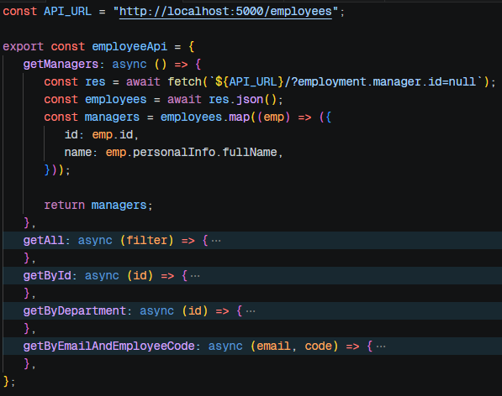

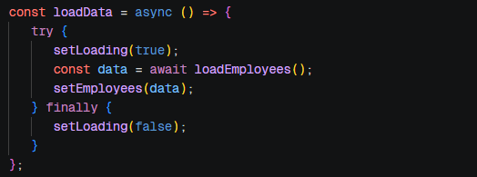
API Integration
employeeApi.js
employee.util.js
Employees.jsx
Notes:
Slide 10: API Integration & Data Flow
Title
API Integration & Data Flow Architecture
API Layer
The application follows a dedicated API layer approach to separate data access from UI components.
API Files
api/
├── employeeApi.js
├── departmentApi.js
└── attendanceApi.js
Why Separate API Logic?
Instead of calling APIs directly inside components:
❌ Difficult to maintain
❌ Repeated API calls
❌ Tight coupling between UI and data layer
Using a dedicated API layer:
✅ Cleaner code
✅ Better maintainability
✅ Easier debugging
✅ Reusable API functions
Data Flow Architecture
API Layer
│
▼
Custom Hooks
│
▼
Components
│
▼
Pages
│
▼
User Interface
Real Project Example
Employee Module
employeeApi.js
│
▼
useEmployeeFilters()
│
▼
EmployeeTable.jsx
│
▼
Employees.jsx
Attendance Module
attendanceApi.js
│
▼
useAttendanceFilter()
│
▼
AttendanceTable.jsx
│
▼
Attendance.jsx
Request Lifecycle
User Opens Page
│
▼
Component Loads
│
▼
Hook Calls API Function
│
▼
API Returns Data
│
▼
Data Processed
│
▼
UI Updated
Separation of Responsibilities
LayerResponsibilityPagesUser interactionsComponentsUI renderingHooksBusiness logicAPI LayerData fetchingUtilsData transformation
Benefits Achieved
Maintainability
API changes affect only one layer
Reusability
Same API methods can be used in multiple components
Scalability
Easy to add new modules and endpoints
Testability
Business logic separated from UI
Speaker Notes
The application uses a dedicated API layer to manage all data-related operations. Instead of fetching data directly inside components, API calls are centralized within separate files. Components consume processed data through custom hooks, resulting in a clean separation between presentation, business logic, and data access layers.
Visual Enhancement (Highly Recommended)
Create a simple diagram:
Employees Page
│
▼
EmployeeTable
│
▼
useEmployeeFilters
│
▼
employeeApi.js
│
▼
Backend/Data Source
This gives reviewers a clear picture of how data flows through your application.
Slide 11: Dashboard Module
Now we start discussing the actual application features.
This slide will showcase:
Dashboard page
Summary cards
Statistics
useDashboardSummary
StatCard
Overall system insights
This is usually where you start inserting screenshots from the application.

Slide 11
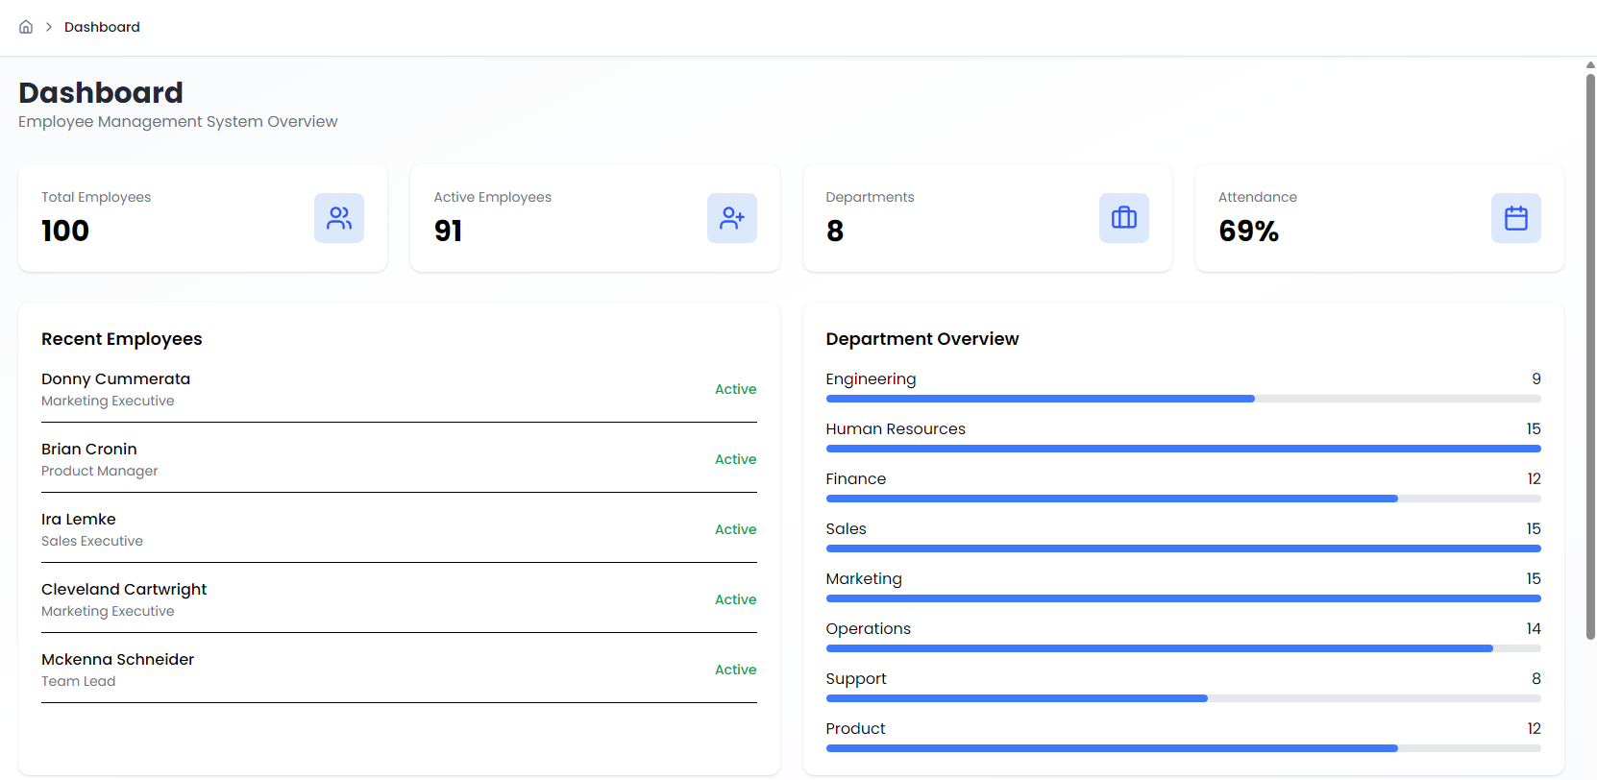
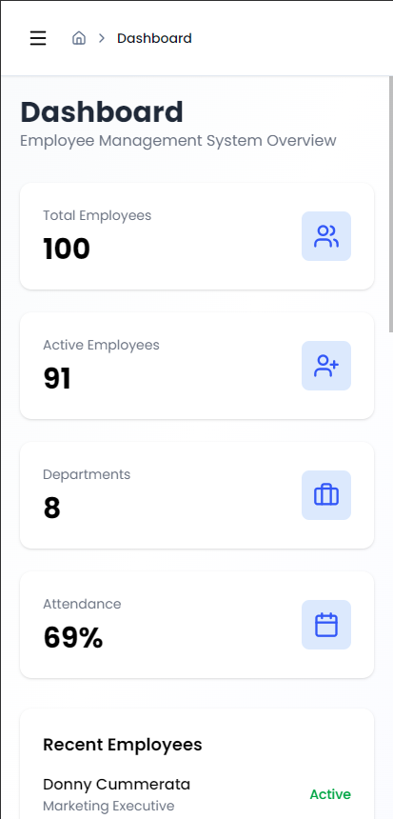
Dashboard Module
Showcases statistics, summery cards and analytics
Notes:
Slide 11: Dashboard Module
Title
Dashboard Module
Purpose
The Dashboard serves as the central overview page of the Employee Management System, providing quick access to key organizational insights.
Key Features
Summary Statistics
Displays important metrics such as:
Total Employees
Total Departments
Attendance Overview
Payroll Summary
Quick Insights
Provides users with:
Workforce overview
Department distribution
Attendance trends
Payroll-related statistics
Components Used
Dashboard.jsx
│
├── StatCard.jsx
├── PayrollStatCard.jsx
└── Header.jsx
Custom Hook Integration
useDashboardSummary()
Responsibilities
Calculate summary statistics
Aggregate employee information
Prepare dashboard metrics
Provide processed data to UI components
Dashboard Architecture
Dashboard Page
│
▼
useDashboardSummary()
│
▼
Processed Statistics
│
▼
StatCard Components
│
▼
Dashboard UI
Reusable Components Used
ComponentPurposeStatCardDisplay key metricsPayrollStatCardPayroll-related statisticsHeaderPage headerBreadcrumbNavigation support
Benefits
✅ Quick access to important information
✅ Improved user experience
✅ Centralized organizational overview
✅ Reusable dashboard widgets
Suggested Screenshot
Insert a screenshot of your Dashboard page and label:
[Total Employees]
[Departments]
[Attendance]
[Payroll]
Add arrows pointing to each card and mention:
"All statistics are dynamically generated through reusable components and custom hooks."
Speaker Notes
The Dashboard acts as the entry point after authentication and provides users with a consolidated view of organizational data. Summary statistics are generated using the useDashboardSummary custom hook and displayed through reusable StatCard components, ensuring consistency and maintainability.
Slide 12: Employee Management Module
This is usually your largest module because it demonstrates:
Employee listing
Employee details
Filtering
Tables
Cards
API integration
Custom hooks
and it showcases most of the React concepts used in the project.

Slide 12
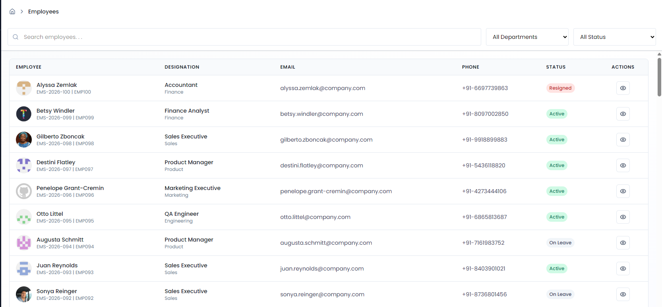
Employee Module
Employee listing
Employee filter
Employee details
Notes:
Slide 12: Employee Management Module
Title
Employee Management Module
Purpose
The Employee module provides a centralized interface for managing and viewing employee information.
Key Features
Employee Listing
View all employees
Organized tabular display
Easy data access
Employee Details
Individual employee information
Detailed employee view
Search & Filtering
Filter employees efficiently
Dynamic data updates
Files Involved
pages/
└── Employees.jsx
components/
├── EmployeeCard.jsx
├── EmployeeDetails.jsx
└── EmployeeTable.jsx
hooks/
└── useEmployeeFilters.js
api/
└── employeeApi.js
Module Architecture
Employees.jsx
│
▼
useEmployeeFilters()
│
▼
employeeApi.js
│
▼
EmployeeTable.jsx
│
▼
EmployeeCard.jsx
Reusable Components Used
ComponentResponsibilityEmployeeTableDisplay employee recordsEmployeeCardEmployee summary informationEmployeeDetailsDetailed employee informationDataTableGeneric table renderingFiltersSearch and filtering
Data Flow
Employee Data
│
▼
API Layer
│
▼
Custom Hook
│
▼
Filtered Data
│
▼
Employee Table
│
▼
User Interface
Custom Hook Usage
useEmployeeFilters()
Responsibilities:
Search employees
Filter records
Manage filtered state
Improve component readability
Benefits Achieved
✅ Efficient employee management
✅ Reusable UI components
✅ Cleaner business logic
✅ Easy data filtering
✅ Scalable architecture
Suggested Screenshot Layout
Insert:
Left Side
Employee List/Table
Right Side
Employee Detail Card
Add labels:
EmployeeTable
│
▼
EmployeeDetails
This visually demonstrates component interaction.
Speaker Notes
The Employee module provides employee listing, filtering, and detailed information display. Data is retrieved through the API layer and processed using the useEmployeeFilters custom hook. Reusable components such as EmployeeTable and EmployeeCard ensure consistency while reducing code duplication.
Slide 13: Department Management Module
This slide will showcase:
Departments page
Department statistics
Department details
Department employee relationships
useDepartmentSummary()
Department cards and tables
This module is particularly useful because it demonstrates how your application handles related data across multiple entities.

Slide 13
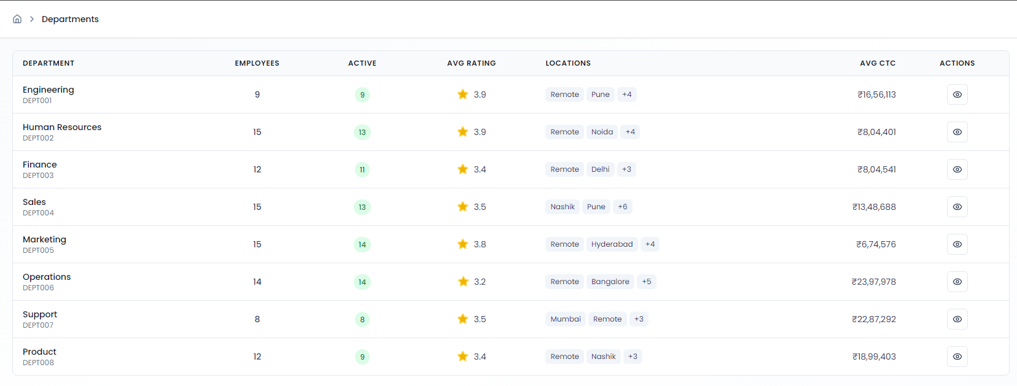
Department Module
Department listing
Department employee mapping
Department details
Notes:
Slide 13: Department Management Module
Title
Department Management Module
Purpose
The Department module helps organize employees into departments and provides department-level insights and statistics.
Key Features
Department Listing
View all departments
Department-wise information
Structured data display
Department Details
Detailed department information
Employee count per department
Department statistics
Department Employees
View employees belonging to a department
Better organizational visibility
Files Involved
pages/
└── Departments.jsx
components/
├── DepartmentCard.jsx
├── DepartmentDetails.jsx
├── DepartmentDetailsTable.jsx
├── DepartmentEmployeeCard.jsx
└── DepartmentTable.jsx
hooks/
└── useDepartmentSummary.js
api/
└── departmentApi.js
Module Architecture
Departments.jsx
│
▼
useDepartmentSummary()
│
▼
departmentApi.js
│
▼
DepartmentTable
│
▼
DepartmentDetails
│
▼
DepartmentEmployeeCard
Reusable Components Used
ComponentPurposeDepartmentCardDepartment summaryDepartmentTableDepartment listingDepartmentDetailsDepartment informationDepartmentEmployeeCardEmployee details within departmentDataTableGeneric data display
Data Flow
Department Data
│
▼
departmentApi.js
│
▼
useDepartmentSummary()
│
▼
Department Components
│
▼
User Interface
Custom Hook Usage
useDepartmentSummary()
Responsibilities:
Calculate department statistics
Process department data
Generate summary information
Prepare dashboard metrics
Benefits Achieved
✅ Organized department management
✅ Department-wise employee tracking
✅ Better workforce visibility
✅ Reusable architecture
✅ Simplified data analysis
Suggested Screenshot Layout
Left Side
Department List/Table
Right Side
Department Details
Bottom
Employees within Selected Department
Example:
Departments
│
▼
Department Details
│
▼
Department Employees
This visually shows the relationship between departments and employees.
Speaker Notes
The Department module provides a structured view of organizational departments and their employees. It leverages reusable components and the useDepartmentSummary hook to present department-level statistics and employee distribution. This helps users understand organizational structure and workforce allocation.
Slide 14: Attendance Management Module
This is another strong feature module because it showcases:
Attendance records
Attendance details
Monthly attendance summaries
Attendance analytics
Multiple custom hooks
Multiple reusable components
In fact, based on your folder structure, the Attendance module appears to be one of the most feature-rich sections of the application.

Slide 14
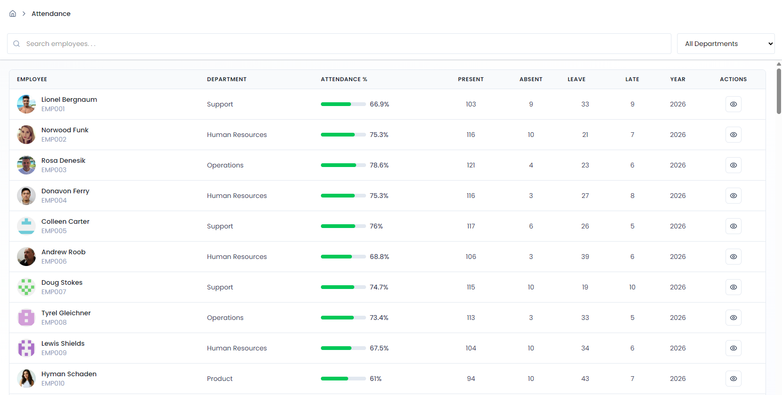
Attendance Module
Attendance Records
Monthly
Detailed tracking
Notes:
Slide 14: Attendance Management Module
Title
Attendance Management Module
Purpose
The Attendance module enables tracking, monitoring, and analyzing employee attendance records.
Key Features
Attendance Tracking
View employee attendance records
Monitor attendance status
Centralized attendance management
Attendance Details
Employee-wise attendance information
Detailed attendance history
Monthly Attendance Summary
Monthly attendance overview
Attendance statistics and insights
Filtering & Search
Filter attendance records
View specific attendance details quickly
Files Involved
pages/
└── Attendance.jsx
components/
├── AttendanceCard.jsx
├── AttendanceDetails.jsx
├── AttendanceDetailsTable.jsx
├── AttendanceMonthCard.jsx
└── AttendanceTable.jsx
hooks/
├── useAttendanceFilter.js
├── useAttendanceDetailsFilter.js
└── useAttendanceSummary.js
api/
└── attendanceApi.js
Module Architecture
Attendance.jsx
│
▼
attendanceApi.js
│
▼
Attendance Hooks
│
┌─────┼─────────┐
▼ ▼ ▼
Filter Summary Details
│ │ │
▼ ▼ ▼
Attendance Components
│
▼
User Interface
Custom Hooks Used
useAttendanceFilter()
Responsibilities:
Search attendance records
Filter attendance data
Manage filtered results
useAttendanceDetailsFilter()
Responsibilities:
Filter detailed attendance records
Handle employee-specific attendance views
useAttendanceSummary()
Responsibilities:
Calculate attendance metrics
Generate monthly summaries
Prepare attendance statistics
Reusable Components Used
ComponentPurposeAttendanceTableAttendance listingAttendanceCardAttendance summaryAttendanceMonthCardMonthly statisticsAttendanceDetailsDetailed recordsAttendanceDetailsTableDetailed attendance tableFiltersSearch and filtering
Data Flow
Attendance API
│
▼
Custom Hooks
│
▼
Processed Attendance Data
│
▼
Cards & Tables
│
▼
Attendance Dashboard
Benefits Achieved
✅ Attendance monitoring
✅ Monthly attendance analytics
✅ Reusable filtering logic
✅ Better workforce tracking
✅ Improved reporting capabilities
Suggested Screenshot Layout
A very effective layout would be:
+------------------------+
| Attendance Summary |
+------------------------+
+------------+-----------+
| Monthly | Details |
| Statistics | Table |
+------------+-----------+
Use arrows to show:
Attendance Data
│
▼
Attendance Summary
│
▼
Attendance Details
Speaker Notes
The Attendance module provides comprehensive attendance management capabilities. Attendance records are retrieved through the API layer, processed using custom hooks, and displayed through reusable cards and tables. Monthly summaries and detailed attendance views help users monitor workforce attendance effectively while maintaining a clean and scalable architecture.
Slide 15: Payroll Management Module
This slide will cover:
Payroll processing
Payroll statistics
Payroll filters
Payroll tables
Payroll cards
usePayRollFilters()
It will also complete the walkthrough of all major business modules in your EMS application.

Slide 15
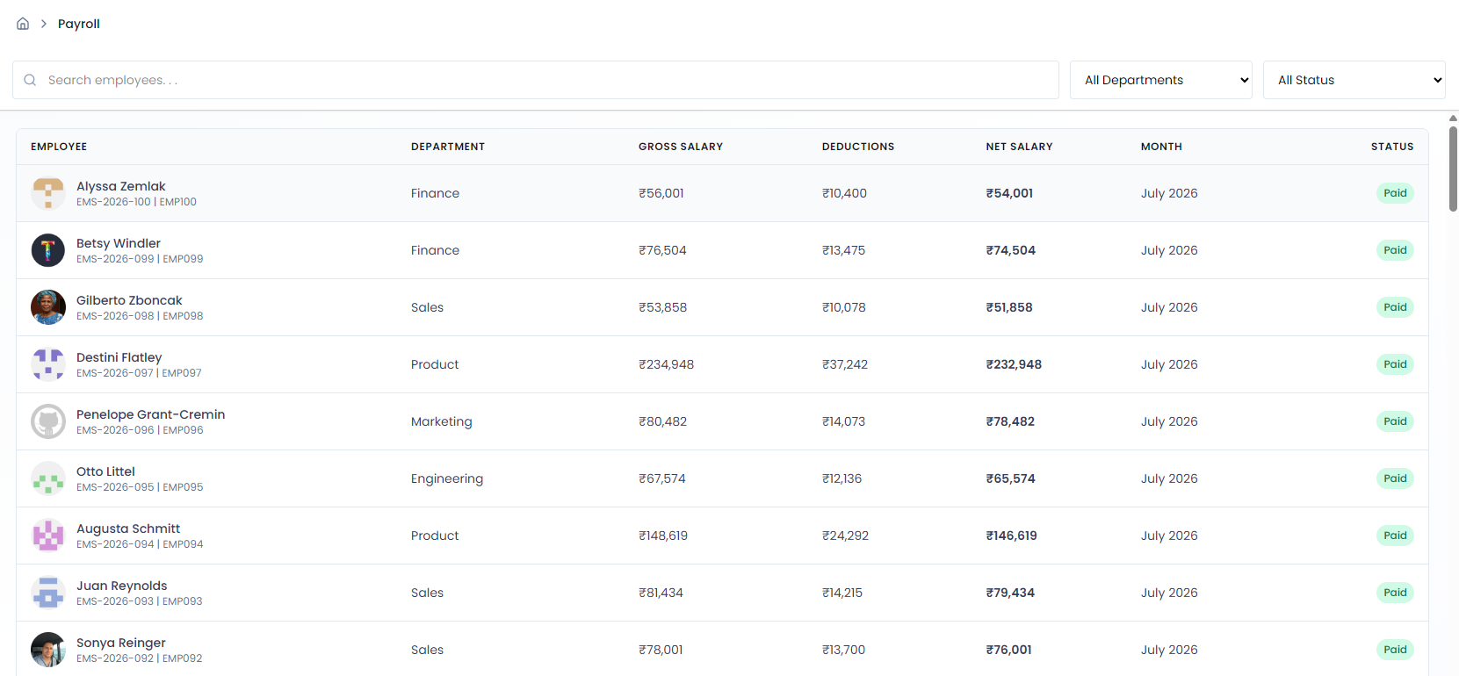
Payroll Module
Payroll Records
Salary Summary
Payroll Statistics
Notes:
Slide 15: Payroll Management Module
Title
Payroll Management Module
Purpose
The Payroll module provides payroll information, salary insights, and compensation-related statistics for employees.
Key Features
Payroll Records
View employee payroll information
Centralized payroll management
Structured salary data display
Payroll Statistics
Payroll summaries
Compensation insights
Organization-wide payroll overview
Payroll Filtering
Search payroll records
Filter employee payroll data
Improve data accessibility
Files Involved
pages/
└── Payroll.jsx
components/
├── PayrollCard.jsx
├── PayrollStatCard.jsx
└── PayrollTable.jsx
hooks/
└── usePayRollFilters.js
layout/
└── payslipLayout.jsx
Module Architecture
Payroll.jsx
│
▼
usePayRollFilters()
│
▼
Filtered Payroll Data
│
┌────┴────┐
▼ ▼
Payroll Payroll
Table Statistics
│ │
▼ ▼
PayrollCard PayrollStatCard
Custom Hook Usage
usePayRollFilters()
Responsibilities:
Search payroll records
Filter employee payroll information
Manage payroll data presentation
Improve component reusability
Reusable Components Used
ComponentPurposePayrollTablePayroll data displayPayrollCardEmployee payroll summaryPayrollStatCardPayroll statisticsFiltersPayroll filteringDataTableGeneric table rendering
Data Flow
Payroll Data
│
▼
Filter Logic
│
▼
Processed Results
│
▼
Payroll Components
│
▼
User Interface
Benefits Achieved
✅ Centralized payroll management
✅ Easy salary information access
✅ Reusable filtering mechanism
✅ Consistent UI design
✅ Improved reporting and analysis
Suggested Screenshot Layout
+--------------------------------+
| Payroll Statistics Cards |
+--------------------------------+
+--------------------------------+
| Payroll Table |
+--------------------------------+
Add labels:
PayrollStatCard
PayrollTable
Filter Component
This visually highlights component reuse.
Speaker Notes
The Payroll module provides employees' compensation information through reusable cards and table components. Payroll data can be filtered and analyzed using the usePayRollFilters custom hook, ensuring a clean separation between business logic and UI rendering. The module follows the same architectural principles used throughout the application, maintaining consistency and scalability.
Slide 16: Code Quality & React Best Practices
This slide is extremely important because it ties everything back to the SMART objective and demonstrates that you didn't just build features—you followed professional React development standards.
We'll showcase:
PropTypes
Reusable Components
Custom Hooks
Context API
Separation of Concerns
Clean Folder Structure
Maintainability
This is often the slide reviewers care about most during technical evaluations.

Slide 16
Conclusion
✅ Developed 20+ React components, including 8 reusable components to reduce code duplication and improve maintainability.
✅ Implemented 20+ functional components using modern React development practices.
✅ Created 7 custom hooks to separate business logic from UI and promote code reusability.
✅ Applied PropTypes validation for improved runtime type checking and component reliability.
✅ Built 5+ pages with nested routing using React Router for seamless navigation.
✅ Implemented authentication and protected routing using Context API and ProtectedRoute.
✅ Followed a clean, modular, and reusable architecture with clear separation of concerns.
Notes:
Slide 16: Code Quality & React Best Practices
Title
Code Quality & React Best Practices
Development Principles Followed
The application was designed with a focus on:
Maintainability
Reusability
Scalability
Readability
Separation of Concerns
React Best Practices Implemented
Functional Components
✅ All components are built using modern React functional components.
Benefits:
Cleaner syntax
Better readability
Hook support
Custom Hooks
Files:
hooks/
├── useEmployeeFilters.js
├── useAttendanceFilter.js
├── useDashboardSummary.js
└── ...
Benefits:
Reusable business logic
Cleaner components
Reduced duplication
Context API
Files:
context/
├── AuthContext.js
└── AuthProvider.jsx
Benefits:
Global state management
Avoid prop drilling
Centralized authentication
PropTypes Validation
Used for:
Runtime prop validation
Improved component reliability
Easier debugging
Example:
Component.propTypes = {
title: PropTypes.string.isRequired,
count: PropTypes.number.isRequired,
};
(Use a screenshot of one of your actual components if possible.)
Separation of Concerns
Pages
↓
Components
↓
Hooks
↓
API Layer
↓
Utilities
Each layer has a single responsibility.
Clean Project Structure
src/
├── pages
├── components
├── hooks
├── api
├── context
├── layout
├── utils
└── constants
Benefits:
Easier navigation
Better maintainability
Improved scalability
Reusability Achieved
Reusable ElementPurposeDataTableGeneric data displayFiltersShared filtering UISidebarCommon navigationHeaderConsistent page layoutCustom HooksShared business logic
Outcome
Before
Duplicate logic
Larger components
Difficult maintenance
After
Reusable architecture
Cleaner codebase
Easier enhancements
Better scalability
Speaker Notes
Throughout the project, React best practices were consistently applied. Business logic was extracted into custom hooks, authentication was centralized using Context API, components were made reusable, and PropTypes were used for validation. These practices improved maintainability, reduced duplication, and ensured the application remains scalable for future enhancements.
Visual Suggestion
Create a simple checklist graphic:
✔ Reusable Components
✔ Custom Hooks
✔ Context API
✔ Protected Routes
✔ PropTypes
✔ Modular Architecture
✔ API Layer Separation
✔ Tailwind CSS
This creates a strong impression during reviews.
Slide 17: Challenges Faced & Solutions
This slide adds real-world engineering value. Instead of only showing what you built, it demonstrates problem-solving skills.
Examples we can tailor to your project:
Managing authentication across pages
Avoiding duplicate filtering logic
Making tables reusable
Organizing a growing codebase
Maintaining consistent UI across modules
This is often one of the most memorable slides in a technical presentation.

Slide 17
Custom Hooks & Business Logic Reusability
Login
Authentication
Valid
Invalid
Dashboard
Employees
Departments
Attendance
Payroll
Notes:
Slide 17: Challenges Faced & Solutions
Title
Challenges Faced & Solutions Implemented
Challenge 1: Repeated Table Implementation
Problem
Multiple modules required table-based data display:
Employees
Departments
Attendance
Payroll
Creating separate tables for each module would lead to:
Code duplication
Difficult maintenance
Inconsistent UI
Solution
Created a reusable:
DataTable.jsx
Result
✅ Single reusable component
✅ Consistent design
✅ Easier maintenance
Challenge 2: Duplicate Filtering Logic
Problem
Every module required:
Search
Filtering
Data processing
Keeping this logic inside components would make them large and difficult to manage.
Solution
Created custom hooks:
useEmployeeFilters()
useAttendanceFilter()
useAttendanceDetailsFilter()
usePayRollFilters()
Result
✅ Cleaner components
✅ Reusable logic
✅ Better separation of concerns
Challenge 3: Route Security
Problem
Users could potentially access pages directly through URLs without proper authentication.
Solution
Implemented:
ProtectedRoute.jsx
AuthContext
AuthProvider
Result
✅ Secure navigation
✅ Controlled access
✅ Better user experience
Challenge 4: Global Authentication State
Problem
Authentication information needed to be shared across multiple pages.
Without global state:
Prop drilling
Increased complexity
Difficult maintenance
Solution
Implemented:
React Context API
Result
✅ Centralized authentication
✅ Simplified state management
✅ Cleaner architecture
Challenge 5: Growing Project Structure
Problem
As features increased:
More components
More business logic
More data handling
Risk:
Unorganized codebase
Difficult scalability
Solution
Adopted modular folder structure:
pages/
components/
hooks/
api/
context/
utils/
layout/
Result
✅ Organized architecture
✅ Easier feature expansion
✅ Improved maintainability
Summary Table
ChallengeSolutionDuplicate TablesReusable DataTableRepeated Filtering LogicCustom HooksRoute SecurityProtected RoutesGlobal State SharingContext APIProject ScalabilityModular Architecture
Key Learning Outcomes
Technical Skills
React Router
Context API
Custom Hooks
Component Reusability
Modular Architecture
Engineering Skills
Problem Solving
Code Organization
Maintainability Planning
Scalability Design
Speaker Notes
During development, several challenges were encountered related to reusability, authentication, state management, and project organization. These challenges were addressed through reusable components, custom hooks, Context API, and modular architecture. The solutions not only resolved immediate issues but also improved the long-term maintainability and scalability of the application.
Slide 18: Results & SMART Objective Achievement
This is one of the most important closing slides because it explicitly proves that the project met the objectives shown in your SMART objective document.
We'll map:
Objective → Implementation → Result
Reusable Components → Achieved
Routing → Achieved
Context API → Achieved
Hooks → Achieved
Maintainability → Achieved
This slide serves as your "evidence of success" before the conclusion and demo slides.

Slide 18
Custom Hooks & Business Logic Reusability
Login
Authentication
Valid
Invalid
Dashboard
Employees
Departments
Attendance
Payroll
Notes:
Slide 18: Results & SMART Objective Achievement
Title
Results & SMART Objective Achievement
SMART Objective
Improve the quality and maintainability of the React application by developing reusable components and following coding standards.
Objective vs Achievement
ObjectiveImplementationStatusCreate reusable componentsHeader, Sidebar, DataTable, Filters, InfoCard, Breadcrumb, PageLoader, EmptyState✅ AchievedDemonstrate React RouterRouter configuration and navigation✅ AchievedImplement protected routingProtectedRoute + Context API✅ AchievedImprove maintainabilityModular folder structure✅ AchievedReduce code duplicationReusable components + custom hooks✅ AchievedFollow React best practicesHooks, Context API, PropTypes✅ AchievedEnhance scalabilityLayered architecture✅ Achieved
Key Deliverables Completed
Authentication System
✅ Login Page
✅ Context API
✅ Protected Routes
Routing System
✅ Dashboard
✅ Employees
✅ Departments
✅ Attendance
✅ Payroll
Reusable Components
Header
Sidebar
DataTable
Filters
Breadcrumb
InfoCard
PageLoader
EmptyState
Custom Hooks
useDashboardSummary()
useEmployeeFilters()
useDepartmentSummary()
useAttendanceFilter()
useAttendanceDetailsFilter()
useAttendanceSummary()
usePayRollFilters()
Project Metrics
Based on your structure:
CategoryCountPages6API Files3Custom Hooks7Layouts5Reusable Components20+Context Providers1Protected Routes1
(These numbers make the project look substantial and measurable.)
Architectural Improvements Achieved
Before
UI + Logic + Data
All mixed together
Problems:
Difficult maintenance
Duplicate code
Hard scalability
After
Pages
↓
Components
↓
Hooks
↓
API Layer
↓
Utilities
Benefits:
Clean architecture
Easier maintenance
Better scalability
Overall Impact
Code Quality
⬆ Improved
Reusability
⬆ Increased
Maintainability
⬆ Enhanced
Scalability
⬆ Improved
User Experience
⬆ Better Navigation & Organization
Success Summary
SMART Objective
│
▼
Reusable Components
│
▼
Custom Hooks
│
▼
Protected Routes
│
▼
Clean Architecture
│
▼
Maintainable React Application
Speaker Notes
All SMART objective requirements were successfully achieved. Reusable components were implemented across multiple modules, React Router and protected navigation were integrated, authentication was managed using Context API, and business logic was extracted into custom hooks. These improvements significantly enhanced the maintainability, scalability, and overall quality of the application.
Slide 19: Future Enhancements
This is a short but very professional slide. It shows that you understand how the project could evolve beyond its current scope and demonstrates architectural thinking.

Slide 19
Custom Hooks & Business Logic Reusability
Login
Authentication
Valid
Invalid
Dashboard
Employees
Departments
Attendance
Payroll
Notes:
Slide 19: Future Enhancements
Title
Future Enhancements
Purpose
The current Employee Management System provides a strong foundation and can be extended with additional enterprise-level features.
Planned Enhancements
Role-Based Access Control (RBAC)
Current:
Authentication-based access
Future:
Admin
HR Manager
Employee
Benefits:
✅ Better security
✅ Fine-grained permissions
Real Backend Integration
Current:
API layer abstraction
Future:
REST APIs
Node.js / Spring Boot backend
Database integration
Benefits:
✅ Real-time data management
✅ Persistent storage
Advanced Reporting
Future Features:
Attendance reports
Payroll reports
Department analytics
Employee performance reports
Benefits:
✅ Better decision-making
✅ Improved insights
Data Visualization
Add:
Charts
Graphs
Trend analysis
Examples:
Employee Growth
Attendance Trends
Payroll Distribution
Department Statistics
Benefits:
✅ Better dashboard experience
✅ Enhanced analytics
Export Functionality
Support:
PDF Export
Excel Export
CSV Download
Use Cases:
Attendance Reports
Payroll Reports
Employee Lists
Notification System
Future Features:
Attendance alerts
Payroll notifications
Employee updates
Department announcements
Benefits:
✅ Improved communication
Responsive Mobile Experience
Enhancements:
Mobile-first optimization
Tablet support
Progressive Web App (PWA)
Benefits:
✅ Better accessibility
✅ Anywhere access
Future Architecture Vision
EMS Application
│
┌────┼────┐
▼ ▼ ▼
Backend Database Analytics
│
▼
Reporting & Insights
Benefits of Current Architecture
Because the project already follows:
✅ Reusable Components
✅ Custom Hooks
✅ Context API
✅ Modular Structure
New features can be added with minimal changes to existing code.
Speaker Notes
The application has been designed with scalability in mind. Future enhancements may include role-based access control, backend integration, advanced reporting, data visualization, export functionality, and mobile optimization. The modular architecture adopted during development makes it easier to introduce these features without significant restructuring.
Slide 20: Conclusion
This should be your final content slide before the Q&A/demo. It summarizes the entire project in one concise, professional slide and leaves a strong final impression. After that, we'll do a simple Slide 21: Thank You & Questions.

Slide 20
Custom Hooks & Business Logic Reusability
Login
Authentication
Valid
Invalid
Dashboard
Employees
Departments
Attendance
Payroll
Notes:
Slide 20: Conclusion
Title
Conclusion
Project Summary
The Employee Management System (EMS) was successfully developed using modern React technologies and best practices.
The application provides:
Employee Management
Department Management
Attendance Tracking
Payroll Management
Secure Authentication
Protected Navigation
Technologies Utilized
React
Vite
Tailwind CSS
React Router
Context API
Custom Hooks
PropTypes
Key Achievements
Reusable Architecture
✅ Common Components
✅ Shared Layouts
✅ Generic Data Tables
React Best Practices
✅ Functional Components
✅ Custom Hooks
✅ Context API
✅ PropTypes Validation
Clean Code Structure
✅ Separation of Concerns
✅ API Layer Isolation
✅ Utility Functions
✅ Modular Folder Organization
Business Value Delivered
Improved Maintainability
Reduced code duplication
Easier feature updates
Improved Scalability
Modular architecture
Easy future enhancements
Improved User Experience
Intuitive navigation
Consistent interface
Secure access control
Final Outcome
SMART Objective
│
▼
Reusable Components
│
▼
Custom Hooks
│
▼
Protected Routing
│
▼
Clean Architecture
│
▼
Maintainable React Application
Project Highlights
AreaAchievementRoutingReact Router ImplementedAuthenticationContext API + Protected RoutesReusability20+ Reusable ComponentsBusiness Logic7 Custom HooksArchitectureModular & ScalableUI DesignTailwind CSS
Closing Statement
This project successfully demonstrates how modern React development practices can be applied to build a scalable, maintainable, and user-friendly Employee Management System while achieving all defined SMART objectives.
Speaker Notes
In conclusion, the Employee Management System successfully fulfills all project objectives by leveraging reusable components, custom hooks, Context API, and protected routing. The application follows a clean architecture that improves maintainability and scalability while delivering a consistent user experience across all modules.
Slide 21: Thank You / Q&A
Title
Thank You
Content
Questions & Discussion
Project
Employee Management System (EMS)
Built with:
React
Vite
Tailwind CSS
React Router
Context API
Contact Information
Your Name
Employee ID (if applicable)
Team / Batch
Visual
Use:
React Logo
Vite Logo
Tailwind Logo
and a screenshot of the Dashboard in the background with light transparency.
Final Presentation Flow
Title
Project Overview
SMART Objective Alignment
Technology Stack
Application Architecture
Routing & Protected Navigation
Reusable Components
Custom Hooks
State Management & Authentication
API Integration & Data Flow
Dashboard Module
Employee Module
Department Module
Attendance Module
Payroll Module
Code Quality & Best Practices
Challenges & Solutions
Results & SMART Objective Achievement
Future Enhancements
Conclusion
Thank You / Q&A
This is a complete, professional 20–25 minute technical presentation that closely matches your project structure and SMART objective requirements.

